Slide 1

Introduction to Locomotor & Multiple Disabilities-5
Unit 4: Deaf-Blindness

Slide 2
Unit 4: Deaf-Blindness
Definition, causes, classification, prevalence and characteristics of deaf-blindness
Effects and implications of deaf-blindness on activities of daily living & education
Screening, assessment, identification & interventional strategies of deaf-blindness
Fostering early communication development: Methods, assistive devices and practices including AAC
Addressing orientation, mobility and educational needs of students with deaf-blindness

Slide 3
Unit 4: Deaf Blindness
Definition, causes, classification, prevalence and characteristics of deaf-blindness
Effects and implications of deaf-blindness on activities of daily living & education
Screening, assessment, identification & interventional strategies of deaf-blindness
Fostering early communication development: Methods, assistive devices and practices including AAC
Addressing orientation, mobility and educational needs of students with deaf-blindness

Slide 4
Education…
Individualised Instruction…
  Individualised plan with realistic expectations from baseline assessment
  Set meaningful targets aiming at as much as independence as possible
  Anticipatory training for deterioration of skills in progressive conditions (like Usher Syndrome)
  Personalised plans for specific transitional stages
  Appropriate setting as per functional level of learner
    Sheltered
    Mainstreamed
  Whatever setting of education – curriculum has be individualised
    Individualised educational plan
    Adapted curriculum

Slide 5
…Education…
Functional Curriculum
  Training in –
    Independent living skills
      For carrying activities of daily living
      To take care of self
    Orientation & mobility
      To get oneself oriented to the environment
      To move around independently
    Communication
      To b’com aware of communicational efforts from environment & respond appropriately
      To express needs, information, thoughts & emotions in social appropriate way
    Functional academics and/or vocational training
      To master reading, writing & number skills necessary for daily life survival
      To acquire productive skills for meaningful occupation of time, and if possible means of earning
    Community living skills
      To integrate with the social milieu
      To maintain mutually contributing relationships

Slide 6
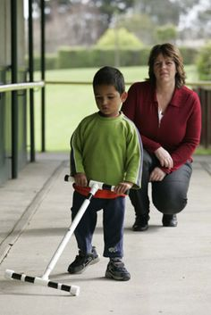
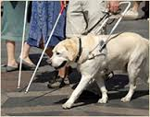
…Education…
Orientation & Mobility…
  More difficult for individuals with loss of both visual & hearing
  As they cannot access both sights & sound signals that are helpful in human environmental navigation
  Hence to make use of alternates like
    Tactile cues
    Adapted signage
    Guide & hearing dogs
    Human assistance

Slide 7
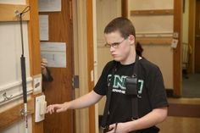

…Education…
Orientation & Mobility…
  Training to get oriented to environment & move around with help of
    Tactual exploration
    Warmth, pressure & light variations in atmosphere
    Residual vision & hearing available
  Adaptations in closed environments
    Structured & simple layout/ floor plan
    Uncomplicated pathways & routes
    Minimal & essential articles & furnishing
    Thorough familiarisation to persons & objects in environment (even tho’ they may not interact regularly/ frequently)
    Adapted (tactile & other) signage at accessible levels

Slide 8
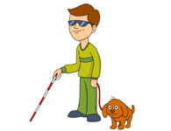
…Education…
Orientation & Mobility…
  Outdoor commutation
    Red & white cane ID
    Human assistance & facilitation, especially in new environments
    Prior orientation & mobility training in custom routes
    Social alerts to (significant) people in the environment
    Training to use of ASSISTANCE CARDS (small printed cards with brief information) along with gestures & other alternate and supportive modes of communication –
      To identify oneself (I’m DEAF-BIND)
      To ask for directions & help (Please help CROSS STREET)
      To suggest means to communicate (TAP ME on side I need to turn)

Slide 9
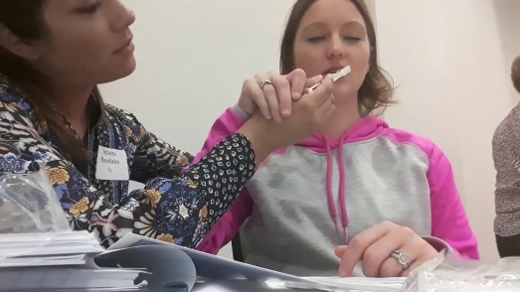
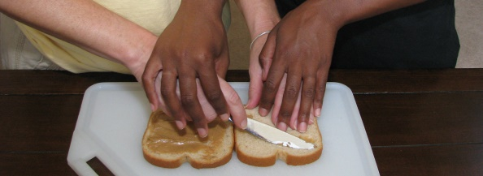
…Education…
Strategies in Education…
  Teaching –learning methods
    Direct teaching: Purposeful instruction in actual situations with real objects
      Hand-over-hand guidance
      Hand-under-hand guidance
      Touch cues
    Develop ability to generalise
  Provision of assistance
    Close & continuous assistance
    Extent of assistance acc’ to ability level of child
      Physical assistance
      Modelling
      Verbal / Tactual guidance & prompts
    Gradual weaning
    Ultimately aiming at total / as much independence as possible

Slide 10
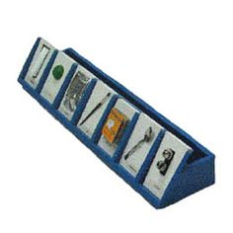
…Education…
Strategies in Education…
  Teaching-learning schedules
    Make use of teachable moment
    Structured routines
      Specific sequence of activities
      Typical methods of training
    More time to complete tasks
    Repetitive exercises for mastery
    Durations acc’ ability level & concentration capability
    Intercessions & diversions whenever necessary

Slide 11

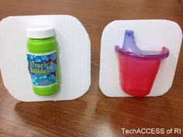
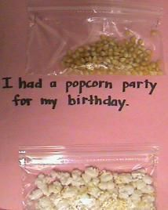
…Education…
Strategies in Education…
  Teaching-learning environment
    Natural setting (as much as possible)
    Modified environment focusing on easy accessibility
    Classroom adaptations with necessary prosthetic fittings
  Teaching-learning aids
    Multisensory, especially providing for tactual input
    Incorporation of variety of real environmental stimuli
    Use of ‘Tactile / Experience Books’ to record learning experiences
    Substituting textbooks / practical records
    With embossed illustrations, samples of learning materials & info in large print and/or braille

Slide 12

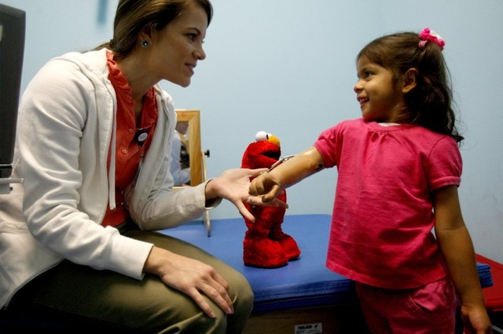
…Education…
Strategies in Education…
  Evaluation
    Periodic
    Based on individualised learning criteria
    Incorporated into learning experience
    Gradual enablement of self-evaluation
    Multidisciplinary perspective
  Reinforcement
    Ample
    Immediate
    Concrete
    Positive & Highly motivating

Slide 13
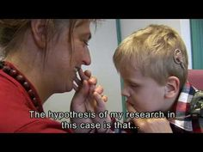
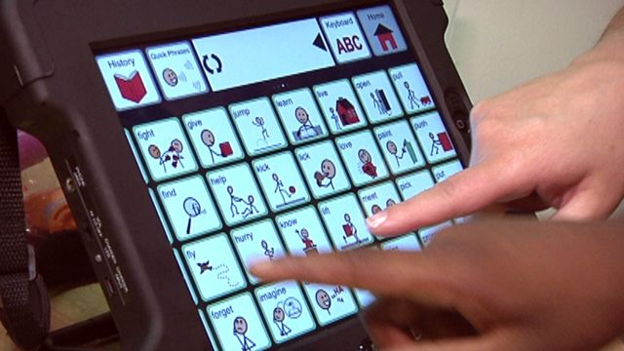
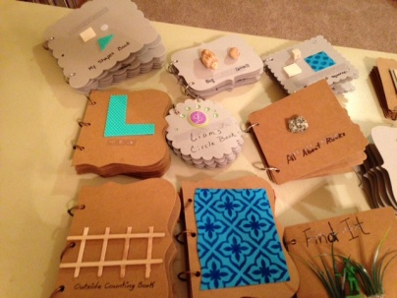
…Education
Explain goal & method (verbal / practical)
Instruction thru’ physical assistance & modeling
Plenty of practice
Enable self-monitoring & Evaluation
Help to generalise
Sequence of Instruction

Slide 14
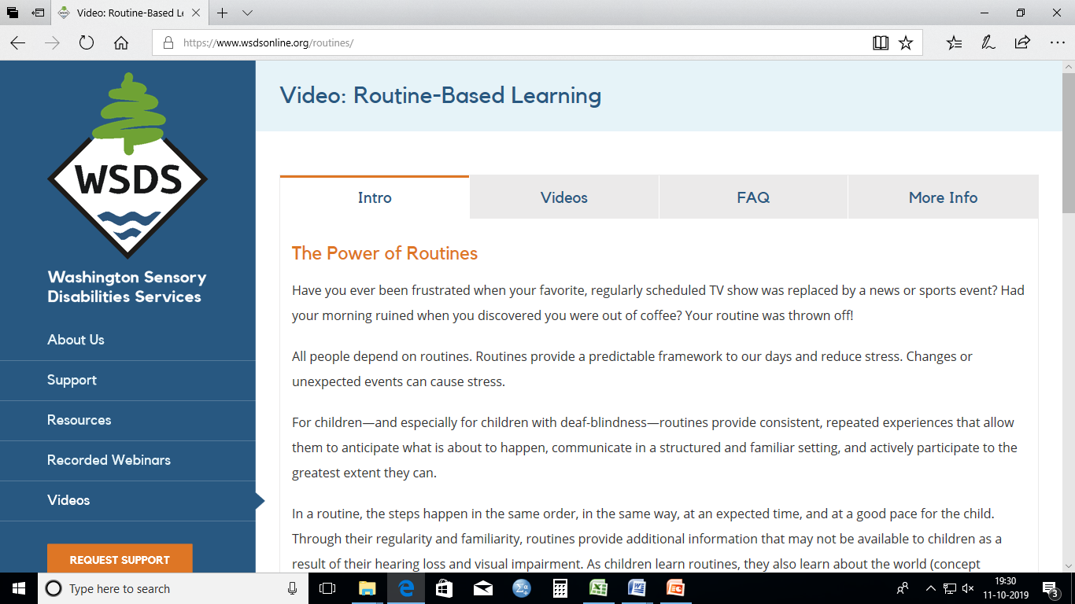
Enrich Your Experience…
You can gain practical knowledge about structured training routines for the deaf-blind by observing videos available at the website of Washington Sensory Disabilities Services https://www.wsdsonline.org/routines/

Slide 15

Further on…
Well done! You have completed the fourth unit, as well as this course on locomotor and multiple disabilities.
I hope that this supplementary exercise was helpful in stabilising and enriching your learning.
This semester, we did not have time to conduct an unit test in this concluding unit, so please proceed further to complete the test online.
I would also like to have your feedback about this online learning platform.
If you have any further doubts or queries please mail to me at malar.aiish@gmail.com

Slide 16
Best Wishes for
Semester Exams

